Slide 1
World Happiness Report 2015
Probability & Statistics Term Project
Presented By:
FARUK MD OMAR-(26013473)
04 JUNE 2026
Sejong university

Slide 2
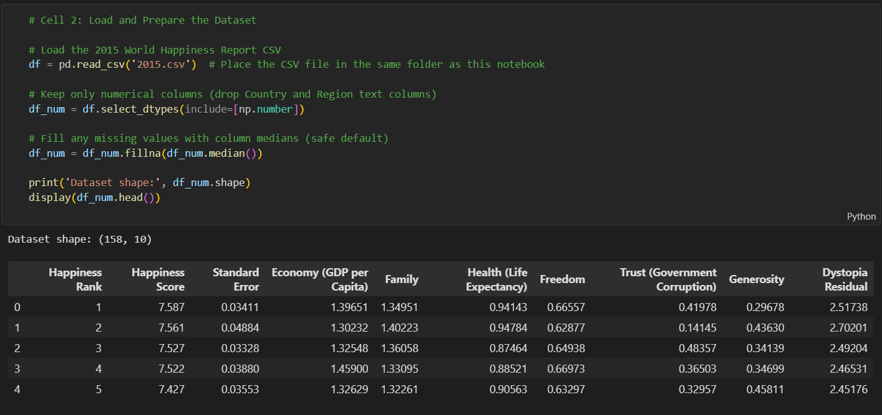
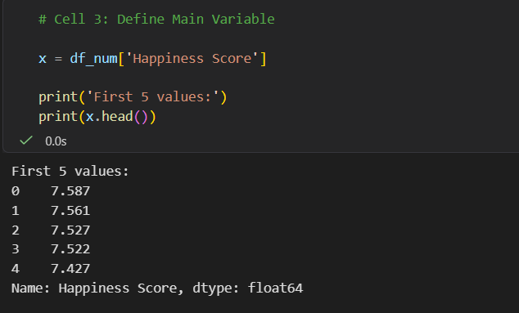
Problem Defination & Dataset
Inquiry:
Can we mathematically predict a nation’s happiness, and how much does wealth actually matters?And instead of guessing, we use data to make predictions.
The dataset consists of 12 columns, 10 of which contain numerical data, comprising a total of 1,580 values.
Target variable:

Slide 3
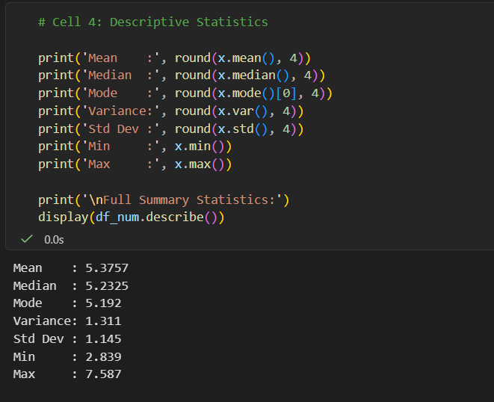
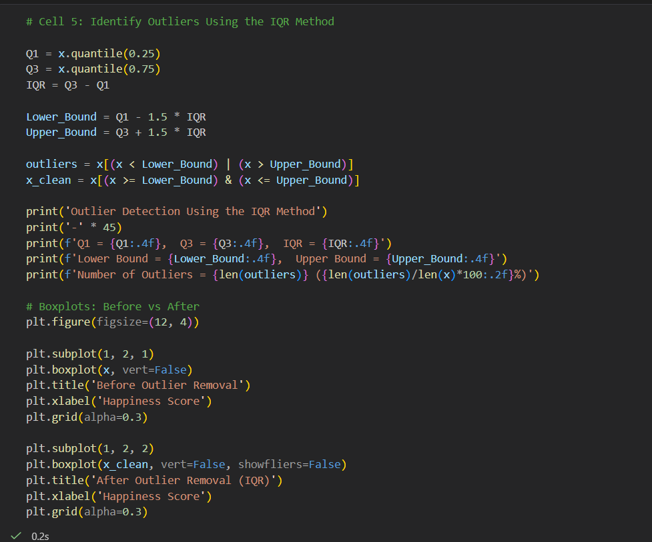
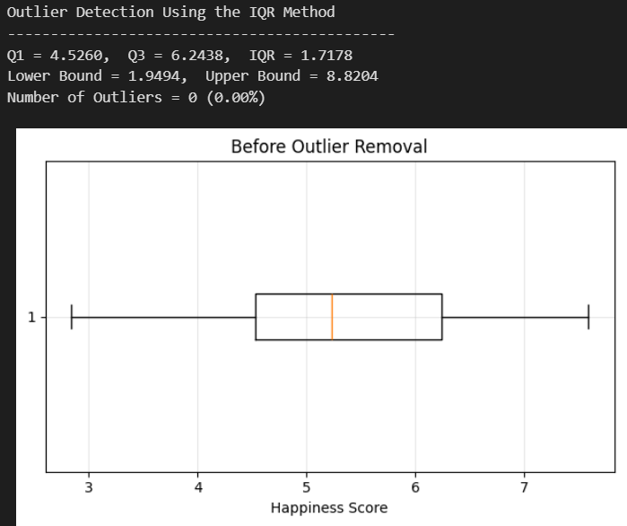
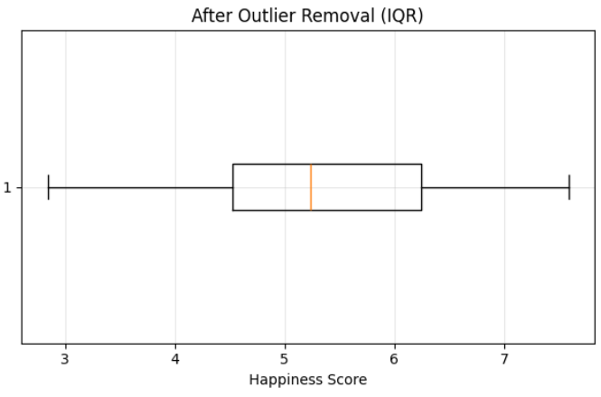
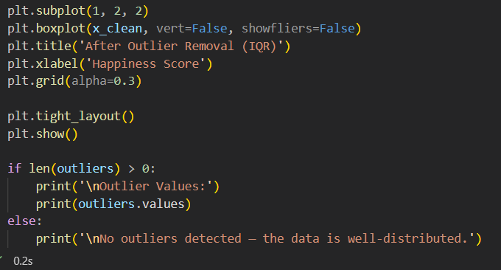
Summary Statistics & Outlier Detection
Descriptive Statistics:
Outlier Analysis:
Zero Outliers Detected: The data contains exactly 0 outliers (0.00%), proving that no single country has a happiness score so extreme that it breaks the data's natural pattern.

Slide 4
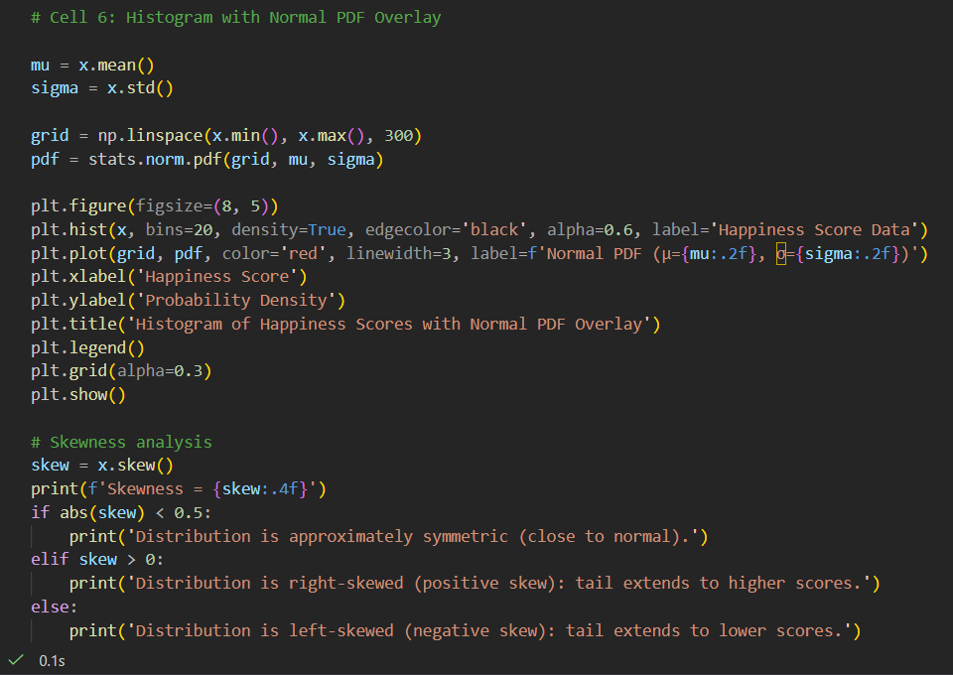
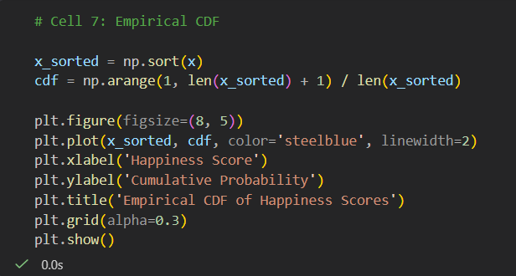
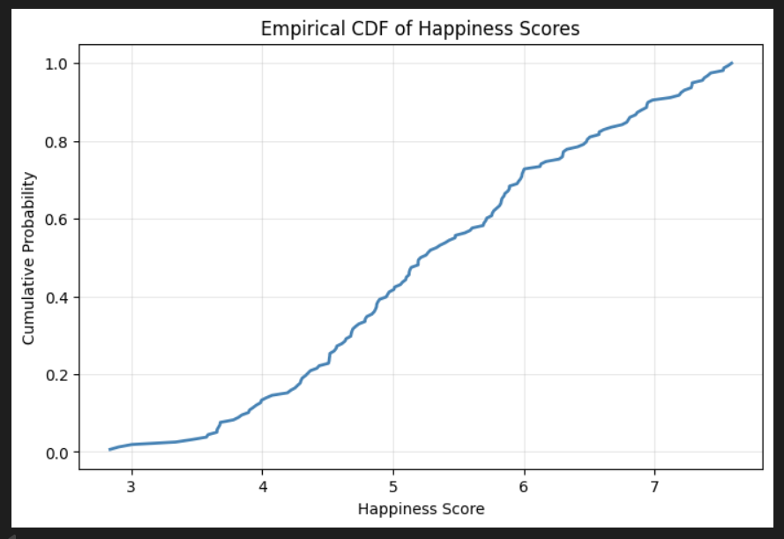
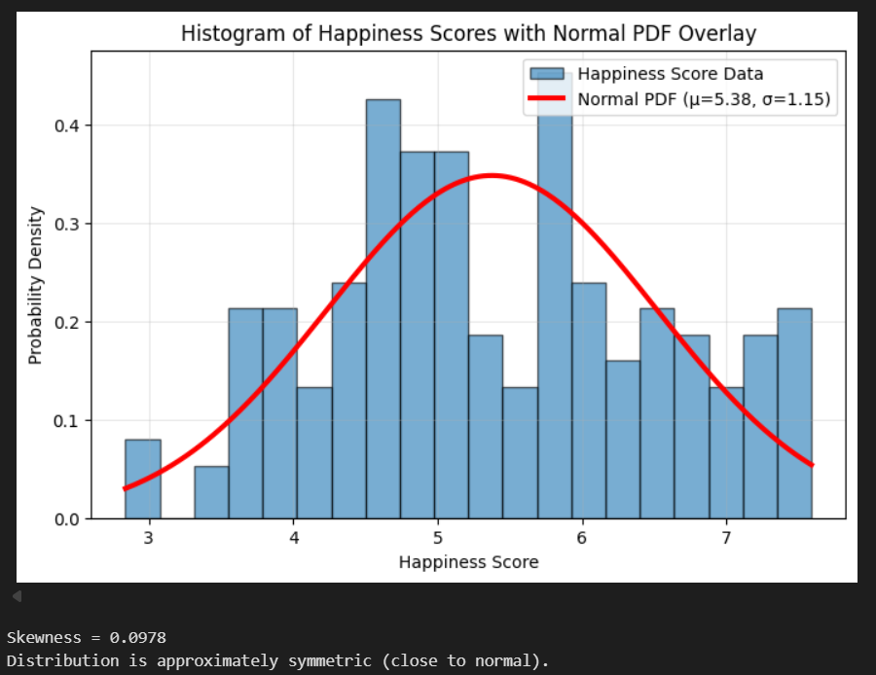
Histogram & CDF
Symmetric Normal Distribution: A negligible skewness score of 0.0978 confirms that the country data is nearly balanced, closely mirroring a theoretical normal bell curve with no major tails.
Gradual Cumulative Scaling: The smooth, steady curve confirms that global happiness increases gradually across all 158 countries without major gaps, visually proving that roughly 40% of nations score a 5.0 or lower, while the remaining 60% score above it.

Slide 5
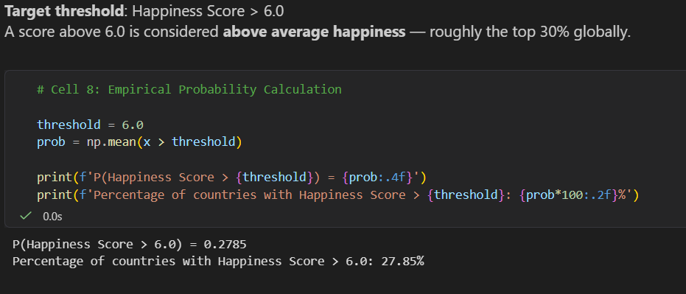
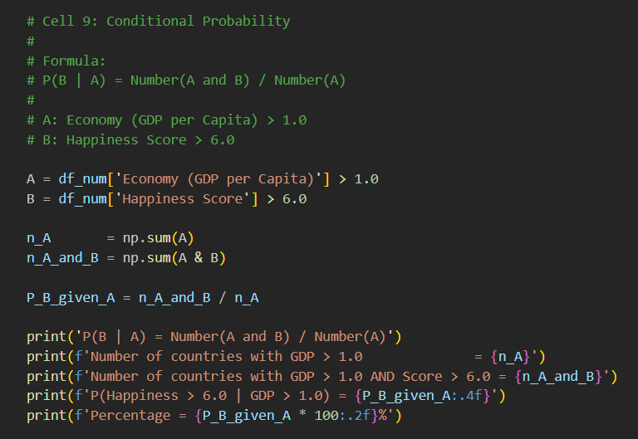
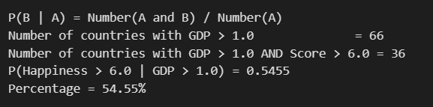
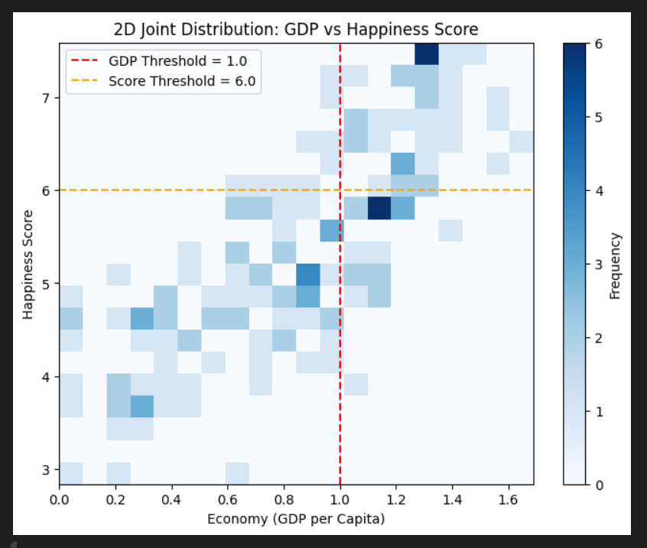
Probability & Conditional Probability
Global Base Rate: Only about 28% of all countries score above 6.0 on the global Happiness Index.
The Economic Catalyst: However, when a country has a strong economy (GDP > 1.0), its chance of entering that high happiness zone doubles to nearly 55%.

Slide 6
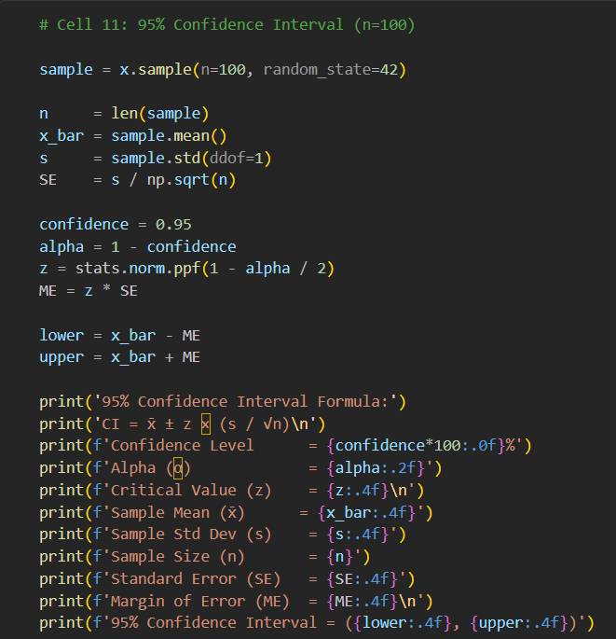
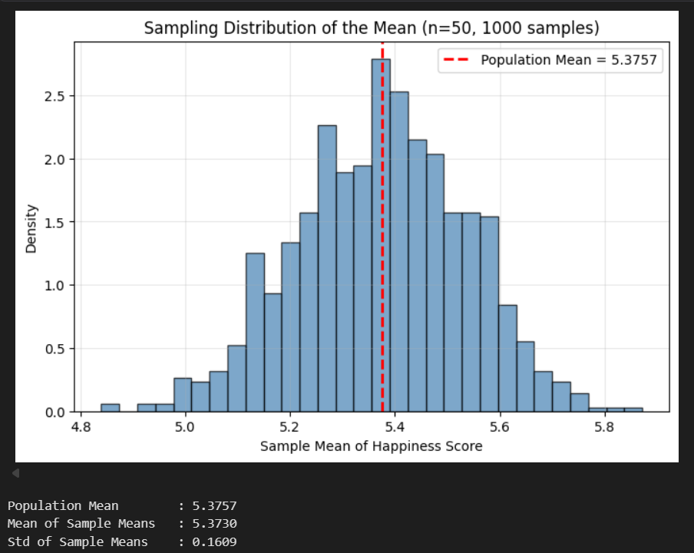
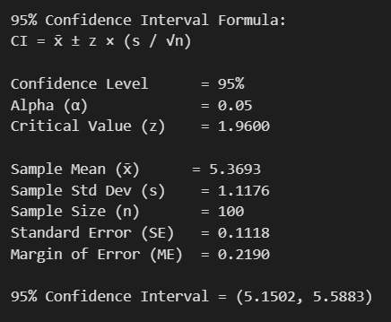
Confidence Interval & Sampling Distribution
The distribution of sample means appears approximately normal.
We are 95% confident that the true average happiness score of the global population lies between 5.1502 and 5.5883.

Slide 7
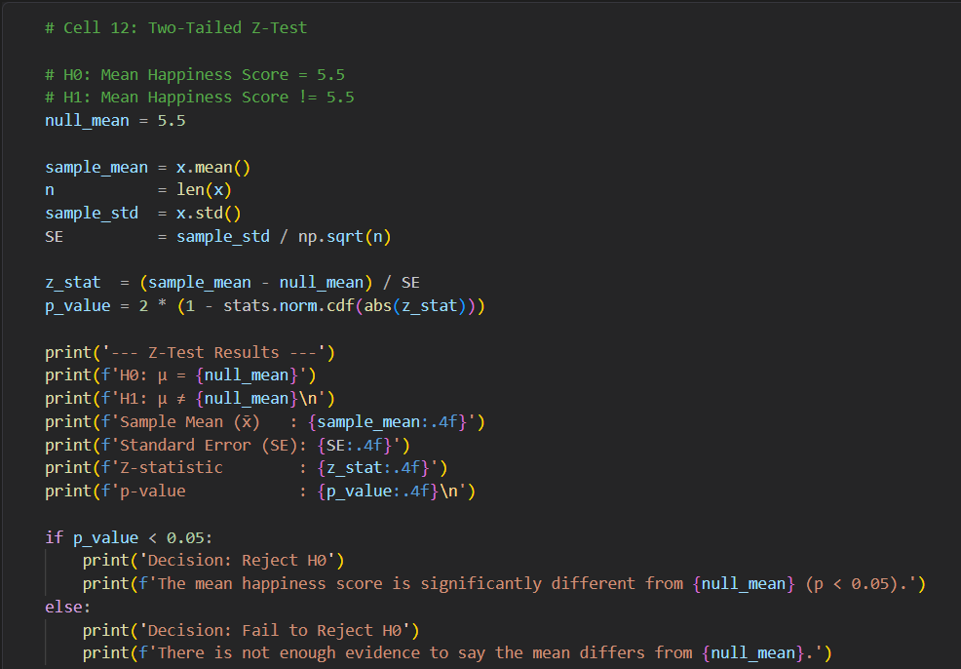
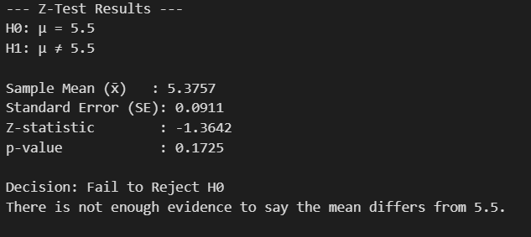
Hypothesis Testing Using a Z-Test
Baseline Selection: The value of 5.5 was selected for the Null Hypothesis (H0) because it represents the absolute neutral midpoint of the 0 to-10 World Happiness scale.
The mean happiness score (5.376) is NOT significantly different from 5.5 (p = 0.172 > 0.05). We fail to reject H₀.

Slide 8
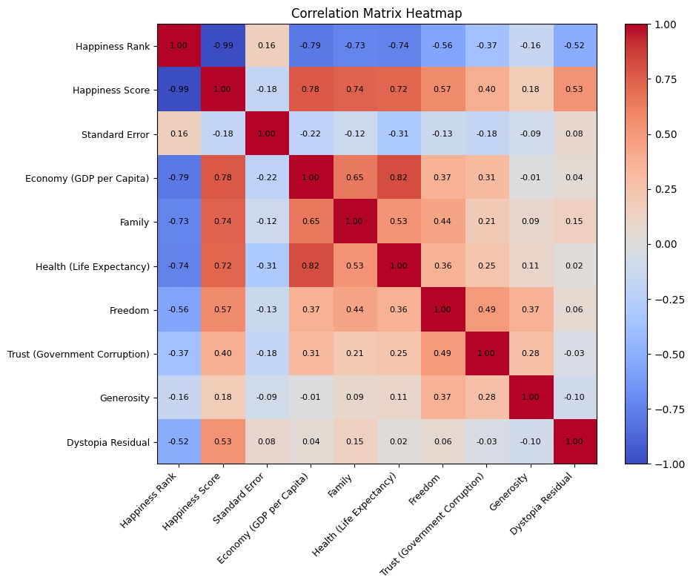
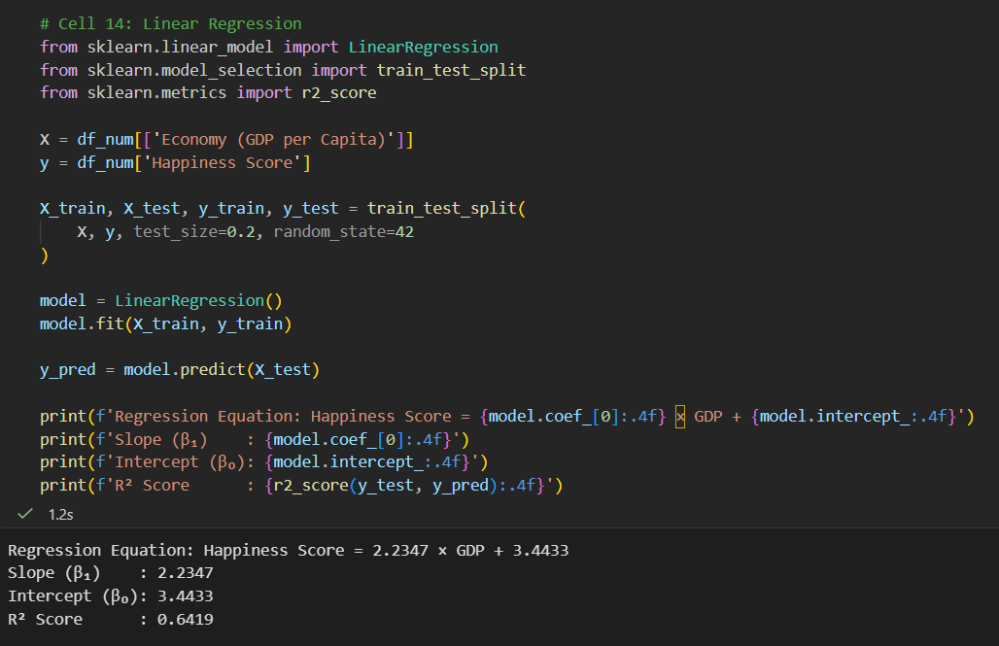
Correlation Matrix & Linear Regression
Impact of Economy : Every 1-unit increase in GDP per capita is predicted to boost a country's happiness score by 2.2347 points, proving a strong positive impact.
Model Accuracy : GDP per capita successfully accounts for 64.19% of the differences in global happiness, leaving only 35.81% to be explained by other external factors.

Slide 9
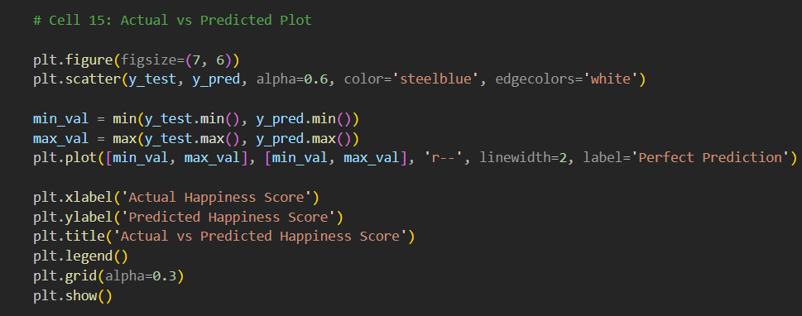
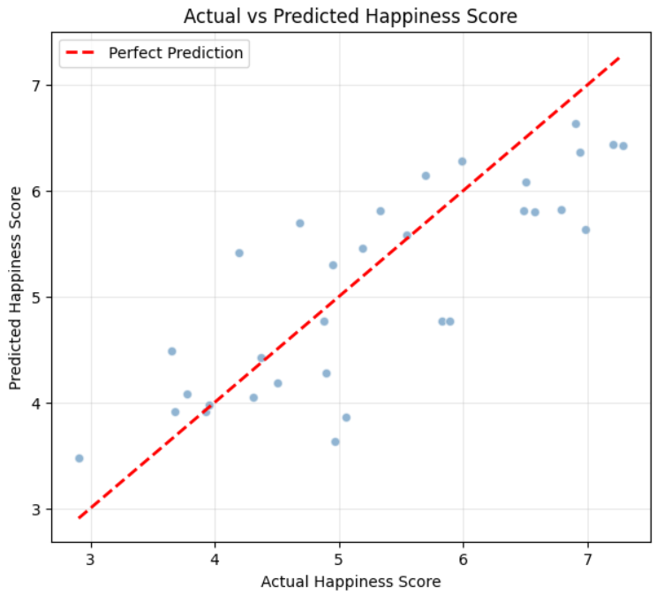
Actual vs. Predicted & Key Takeaways
Economy is the strongest single predictor of happiness.
P(happiness score>6.0)=28%
P(happinessscore>6.0|gdp>1)=55%
The mean happiness score (5.376) is NOT significantly different from 5.5
Regression model achieved R² = 64.19

Slide 10

Thank
You!

